Slide 1

Cyclistic Bike Riding: Analysis
Report by by Peter Blackwell for Cyclistic management
December 17, 2022

Slide 2

Question: How are casual riders of Cyclistic bikes using the system different than subscribers?
This document will present graphs and tables to show how annual members (subscribers) and casual riders use Cyclistic bikes differently so management can make determinations on how to market memberships to casual riders.

Slide 3

Data sources
The source data was taken from the Divvy system data website on AWS
( https://divvy-tripdata.s3.amazonaws.com/index.html )
for the months ranging from Dec. 2021 – Nov. 2022.
(For license see Appendix A)
Because this is uploaded by the Divvy system people, we should assume it conforms to the ROCCC principles (Reliable, Original, Comprehensive, Current, Cited)
The twelve monthly files were extracted and loaded into MS Excel to verify the integrity of the data before analyzing using the R language.

Slide 4
CONCLUSIONS FROM ANALYSIS:
Member riders are using more often on all days
Casual riders are taking longer rides on all days
Member riding is steady all year; casual rides spike in the summer months

Slide 5
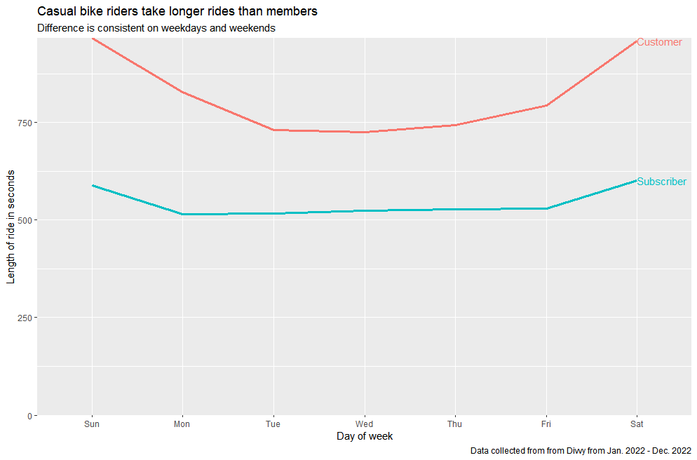

Slide 6
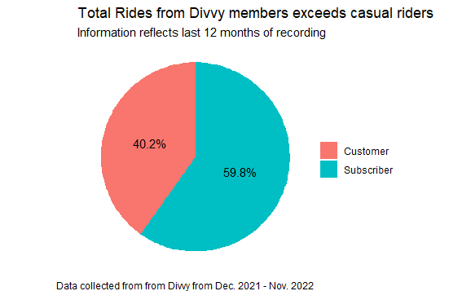

Slide 7
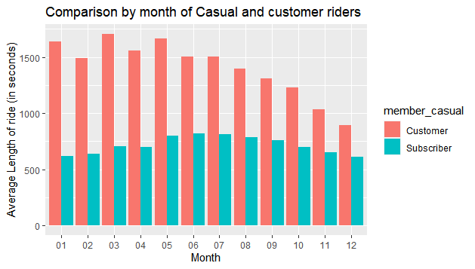

Slide 8
Appendix
License:
Data has been made available by Motivate International Inc. under this license:
https://ride.divvybikes.com/data-license-agreement

